Slide 1
University of Texas, Arlington Arlington, Texas October 27, 2023
Unclassified
Drema Fouch
Management and Program Analyst FBI's Criminal Justice Information Services (CJIS) Division
Unclassified

Slide 2
The Move to the National Incident-Based Reporting System (NIBRS)
By recommendation of the FBI’s CJIS Advisory Policy Board and with the support of the nation's major law enforcement organizations, the FBI’s Uniform Crime Reporting (UCR) Program retired its long-used Summary Reporting System (SRS) and began accepting crime data exclusively via NIBRS–a much more comprehensive data collection system–on January 1, 2021.
Unclassified

Slide 3
Enhancing Law Enforcement Data
The Crime Data Explorer
More timely data including quarterly data releases
National Use-of-Force Data Collection Releases
Provide insight into law enforcement uses of force
Modernization of the Law Enforcement Officers Killed and Assaulted (LEOKA) Data Collection
Analysis of LEOKA forms, updates to definitions to align with modern policing needs
Enhancements to Hate Crime Data Releases
Highlight the importance of collecting hate crime data and provide a national picture of incidents
Unclassified

Slide 4
UCR Program Data Collections
Crime Data
Law Enforcement Data
NIBRS
Provides incident-based details on victims, offenders, arrestees, and property data for each crime occurrence
Hate Crime
Derived from NIBRS
Criminal offenses motivated, in whole or in part, by the offender’s biases
Lawful Access*
Provides insight into the impact encryption has on law enforcement investigations
LEOKA
Provides data on officers who were killed – feloniously or accidentally – and assaulted
Use-of-Force
Offers insight into incidents of police uses of force
Law Enforcement Suicide Data Collection
Provides a better understanding of factors related to law enforcement suicides
Law Enforcement Employee Counts
Provides annual sworn and civilian employee counts
Law Enforcement Public Contact Collection*
Provides context to use of force incidents and zero reports; LEOKA data: submitted annually
*These collections will launch in 2024.
Unclassified
Notes:
NIBRS is the system to report a law enforcement agency’s criminal activity.
As stated, hate crime is derived from NIBRS. An example of a crime motivated by bias is the October 2018, attack on the Tree of Life synagogue in Pittsburgh, PA. The bias was anti-Jewish. 11 people were killed and 6 wounded.
LEOKA – Most recently, the state trooper who was feloniously killed responding to a shots fired call in Mingo County. Three troopers responded to the call and were ambushed.
Use-of-Force – June 2022, a gunman on Interstate 79 who was randomly firing shots. When the police responded, the gunman fired at the officers, hitting one in the leg (LEOKA). Officers returned fire, shooting and killing the gunman (use of force).
Criteria for Use of Force:
When a fatality occurs to a person in connection to use of force by a law enforcement officer
When there is serious bodily injury to a person in connection with use-of-force by a law enforcement officer
In the absence of either of these when a firearm is discharged at or in the direction of a person by a law enforcement officer
LESDC – suicide or attempted suicide data of a current or former law enforcement officer, corrections officer, telecommunications employee (dispatch) or judicial (prosecutor/judge, etc.).

Slide 5
The Future of Crime and Law Enforcement Data
The FBI’s UCR Program continues to enhance crime and law enforcement data to ensure the information captured and reported is relevant to the law enforcement community.
These enhancements ensure:
Transparency
Accuracy
Reliability
The FBI’s UCR Program continues to evolve with the support of federal, state, local, territorial, and tribal law enforcement partners.
Unclassified

Slide 6
NIBRS Landscape Then and Now
Participation Comparison: 2016 vs 2023
2016 | 2023*
16 NIBRS-only states 17 states reported NIBRS or SRS data 15 SRS-only states | Every state is NIBRS certified 20 states are fully NIBRS 30 states not fully NIBRS
2 states did not have a state UCR program (Indiana and Mississippi) | Metropolitan Police Department of the District of Columbia is NIBRS certified
3 U. S. territories were reporting data | Guam is the first U.S. territory NIBRS certified and reporting
189 tribal agencies were reporting data | 176 tribal agencies are reporting data
5 federal agencies were reporting data | 49 federal agencies are reporting data to the UCR Program
*As of October 25, 2023
Unclassified

Slide 7
Texas (TX) NIBRS Participation
*2023 data are year to date
Unclassified

Slide 8
National NIBRS Participation
*2023 data are year to date
Unclassified

Slide 9
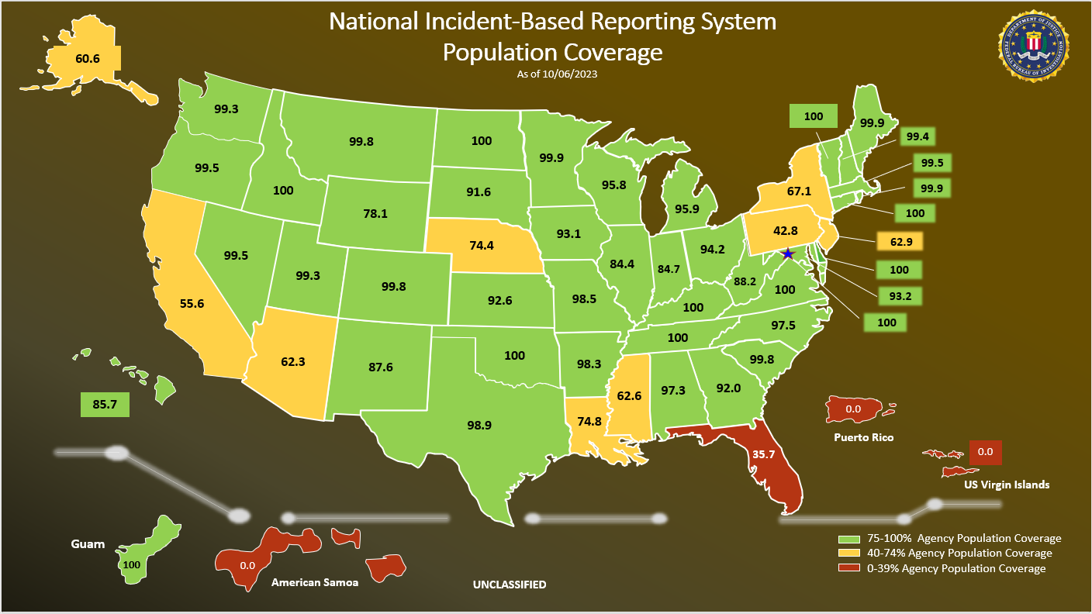
Unclassified

Slide 10
2023 Participation Comparison: TX vs Nation (includes U.S. Territories)
Texas | Nation
TX became NIBRS compliant in July 1998. | Every state is NIBRS certified.
1,172 of 1,317 agencies are reporting data to the UCR Program | 13,186 of 19,115 agencies are reporting data to the UCR Program
675 Cities 238 Counties 0 State Police 0 Other State Agencies (fire marshal, natural resources, etc.) 77 Colleges and Universities 1 Tribal 181 Other Agencies (task forces, parks/ recreation) | 8,172 Cities 2,498 Counties 795 State Police 632 Colleges and Universities 419 Other State Agencies 444 Other Agencies 176 Tribal Agencies 49 Federal Agencies 1 U. S. Territory (Guam)
Unclassified
Notes:
WV Data: National Data:
71 of 169 cities 8,431 of 11,862 cities
47 of 55 counties 2,570 of 3.027 counties
58 of 69 state police detachments 808 of 1,108 state police agencies
28 of 112 other state agencies 420 of 1,103 other state agencies
6 of 12 colleges and universities 652 of 907 colleges and universities
7 of 18 other agencies 380 of 665 other agencies
182 of 214 tribal agencies
46 of 86 federal agencies

Slide 11
Impacts of Non-Participation
Loss of law enforcement officer assault data
Loss of hate crime data
Inability to produce crime trends, crime rates, and violent crime statistics using traditional UCR methods
Unclassified
Notes:
These datasets are high profile collections and the loss of these data impact our ability to release information about these criminal incidents.
In addition, without data from these 5,500 agencies impacts our ability to produce crime trends, rates of crime, and release of violent crime data.

Slide 12
Benefits of NIBRS
Provides greater context to help identify specific crime issues.
Enables more accurate crime analysis.
Helps agencies make better policing decisions and drive resource planning.
Offers transparency that can improve law enforcement relationships with the communities they serve.
Provides a more precise narrative regarding the scope, type, and nature of crime.
Unclassified

Slide 13
Reporting Comparison: NIBRS vs SRS
NIBRS
Collects data on each crime occurrence
3 Crime Classifications: Persons, Property, Society
28 Offense Categories
71 Offenses
19 Offenses only for federal and tribal agencies
10 Arrest Categories
3 Offenses only for federal and tribal agencies
59 Data Elements
1 Data Element is for federal agencies only
Up to 10 Offenses per Incident
No Hierarchy Rule
SRS
12 Separate Reports
2 Crime Classifications: Persons, Property
10 Offense Categories
Aggregate-only Totals
Hierarchy Rule
Unclassified

Slide 14
Reporting Comparison: NIBRS vs SRS
NIBRS
Other Details:
Date and time of the incident
Location of the incident
Distinction between attempted and completed Group A crimes
Bias motivation
Weapon information for all violent offenses
Type of injury sustained per victim
Victim/known offender/arrestee demographics
Relationships between victims and offenders (violent crimes, kidnaping)
Other victim types collected (law enforcement officer, business, financial institution, government, religious organization, society/public)
Expanded collection of drug-related offenses (cultivation, manufacture, distribution, sale, purchase, use, possession, transportation, or importation)
Use of a computer to perpetuate a crime
SRS
Age, Sex, Race, Ethnicity of Persons Arrested
Monetary Values of Property Stolen/Recovered
Supplemental Data only Collected for Homicides:
Weapon
Relationship of victim to offender
Circumstance
Victim and known offender demographics
Unclassified

Slide 15
Group A Offenses
1. Arson
2. Assault Offenses –
Aggravated Assault
Simple Assault
Intimidation
3. Bribery
4. Burglary/Breaking and Entering
5. Commerce Violations –
Import Violations*
Export Violations*
Federal Liquor Offenses*
Federal Tobacco Offenses*
Wildlife Trafficking*
6. Counterfeiting/Forgery
7. Destruction/Damage/Vandalism
8. Drug/Narcotic Offenses –
Drug/Narcotic Violations
Drug Equipment Violations
9. Embezzlement
10. Espionage*
11. Extortion/Blackmail
12. Fraud Offenses –
False Pretenses/Swindle/Confidence Game
Credit Card/Automatic Teller Machine Fraud
Impersonation
Welfare Fraud
Wire Fraud
Identity Theft
Hacking/Computer Invasion
Money Laundering*
13. Fugitive Offenses –
Fugitive (Harboring Escapee/Concealing from Arrest)*
Flight to Avoid Prosecution*
Flight to Avoid Deportation*
14. Gambling Offenses –
Betting/Wagering
Operating/Promoting/Assisting Gambling
Gambling Equipment Violations
Sports Tampering
15. Homicide Offenses –
Murder and Nonnegligent Manslaughter
Negligent Manslaughter
Justifiable Homicide
*Offenses that can only be reported by a federal or tribal law enforcement agency.
Unclassified

Slide 16
Group A Offenses
16. Human Trafficking
Commercial Sex Acts
Involuntary Servitude
17. Immigration Violations
Illegal Entry into the United States*
False Citizenship*
Smuggling Illegal Aliens*
Re-entry after Deportation*
18. Kidnapping/Abduction
19. Larceny/Theft Offenses –
Pocket-picking
Purse-snatching
Shoplifting
Theft from Building
Theft from Coin-Operated Machine or Device
Theft from Motor Vehicle
Theft of Motor Vehicle Parts or Accessories
All Other Larceny
20. Motor Vehicle Theft
21. Pornography/Obscene Material
22. Prostitution Offenses –
Prostitution
Assisting or Promoting Prostitution
Purchasing Prostitution
23. Robbery
24. Sex Offenses –
Rape
Sodomy
Sexual Assault With An Object
Fondling
Incest
Statutory Rape
Failure to Register as a Sex Offender*
25. Stolen Property Offenses
26. Treason*
27. Weapon Law Violations
Violation of National Firearms Act of 1934*
Weapons of Mass Destruction*
Explosives Violations*
28. Animal Cruelty
*Offenses that can only be reported by a federal or tribal law enforcement agency.
Unclassified

Slide 17
Group B Offenses
1. Curfew/Loitering/Vagrancy
2. Disorderly Conduct
3. Driving Under the Influence
4. Family Offenses (Nonviolent)
5. Liquor Law Violations
6. Trespass of Real Property
7. Failure to Appear*
8. Federal Resource Violations*
9. Perjury*
10. All Other Offenses
Only information about the arrestee are collected for Group B offenses
*Offenses that can only be reported by a federal or tribal law enforcement agency.
Unclassified

Slide 18
Data Elements
Originating Agency Identifier | UCR Offense Code | Type Criminal Activity/Gang Information
Judicial District | Offense Attempted/Completed | Type Weapon/Force Involved
Incident Number | Offender Suspected of Using | Type Property Loss
Cargo Theft | Bias Motivation | Property Description
Incident Date/Hour | Location Type | Value of Property
Cleared Exceptionally | Number of Premises Entered | Date Recovered
Exceptional Clearance Date | Method of Entry | Number of Stolen Motor Vehicles
Unclassified

Slide 19
Data Elements
Number of Recovered Motor Vehicles | Type of Officer Activity/Circumstance | Resident Status (of Victim)
Suspected Drug Type | Officer Assignment Type | Aggravated Assault/Homicide Circumstances
Estimated Drug Quantity | Officer – ORI Other Jurisdiction | Additional Justifiable Homicide Circumstances
Type Drug Measurement | Age (of Victim) | Type Injury
Victim Sequence Number | Sex (of Victim) | Offender Number to be Related
Victim Connected to UCR Offense Code | Race (of Victim) | Relationship of Victim to Offender
Type of Victim | Ethnicity (of Victim) | Offender Sequence Number
Unclassified

Slide 20
Data Elements
Age (of Offender) | Arrest Date | Sex (of Arrestee)
Sex (of Offender) | Type of Arrest | Race (of Arrestee)
Race (of Offender) | Multiple Arrestee Segments Indicator | Ethnicity (of Arrestee)
Ethnicity (of Offender) | UCR Arrest Offense Code | Resident Status (of Arrestee)
Arrestee Sequence Number | Arrestee Was Armed With | Disposition of Arrestee, Under 18
Arrest Transaction Number | Age (of Arrestee)
Unclassified

Slide 21
Data → Information → Knowledge
Data, when analyzed, becomes information.
Data
When communicated, information becomes knowledge.
Information
NIBRS provides the data that, once analyzed and communicated, becomes knowledge that can be used by law enforcement, municipal leaders, media, public, and data users.
Knowledge
Unclassified
Notes:
NIBRS data, when analyzed and shared, becomes knowledge, and how NIBRS data can be translated into actionable knowledge when communicated to the law enforcement agency, stakeholders, or the public.
We only know what the data tells us through data analysis.
What that analysis shows can be communicated back to law enforcement, planners, resource managers, and other users, and can be used:
Address crime occurring in specific locations or to specific population groups
Crime prevention
Used for officer safety
Resource allocations

Slide 22
Benefits to Local Agencies
An example of how NIBRS data, when analyzed, benefits a local agency:
A large university town experienced a spike in the number of vehicle thefts from residential garages.
Residents were leaving their cars unlocked inside their garages, and car thieves were using garage door remotes to access the garages and steal the cars.
Using NIBRS data, specifically the location type, offense type, and stolen property descriptions helped identify this trend.
The police department decreased these vehicle thefts by increasing neighborhood patrols and through public awareness activities.
Unclassified

Slide 23
Relationship between Crime Analysis and Incident-Based Reporting Systems
NIBRS is a result of the flow of information from the local law enforcement agency, to the state UCR program, and finally to the FBI’s UCR Program.
State
National
Local
Operational analyses is mainly concerned with a particular jurisdiction, and aids crime reduction strategies which is commonly associated with community-oriented policing or problem-oriented policing.
Strategic intelligence provides insight and understanding into patterns of criminal behavior.
Strategic intelligence influences long-term organizational objectives: policy, resource allocation, and strategy.
Tactical analysis uses the most detailed information and focuses on a particular crime or set of crimes.
Addresses operational and tactical questions.
Addresses mainly operational and strategic questions.
Addresses strategic questions.
Unclassified
Notes:
For municipal leaders, NIBRS data can be used to address not only operational questions officials can use NIBRS data to develop strategies to address crime in their communities, and it can help leaders enact policy and allocate resources.

Slide 24
Using NIBRS data enables an agency to:
Benchmark
NIBRS data will improve law enforcement’s ability to benchmark its own data against similar agencies.
Most benchmarking focuses on basic counts of offenses. However, NIBRS allows agencies to further refine their analyses to include additional characteristics of crimes such as type of weapon used, location, date, and time of incident.
Allocate resources
More refined analysis can also assist law enforcement in identifying areas or concerns to be addressed. Agencies can isolate incidents with key characteristics such as drug/narcotic violations, large dollar value seizures, firearm-related crimes, etc.
Plan for future resources
NIBRS data can enable forward looking analysis of local data in addition to assessing an agency’s effectiveness in its response to current issues.
Enact effective policies
Analyzing and identifying common characteristics of crime can help policymakers enact policy that can address recurring crime trends.
Educate the public
NIBRS data is an effective tool to help educate the public about crime in their community. It promotes transparency and trust.
Unclassified
Notes:
Not only do police departments like to benchmark themselves against each other, municipal leaders can use NIBRS participation to benchmark their communities against neighboring communities.

Slide 25
NIBRS data can show:
Incidents with Drugs/Narcotics Seized by Suspected Drug Type, 2022
¹In NIBRS, an incident may include up to three suspected drug types. Because some incidents were counted more than once to attribute them to each suspected drug type, counts by suspected drug type do not add to the total.
Unclassified

Slide 26
NIBRS data can show:
Unclassified
Notes:
¹Because law enforcement can report up to three types of weapons/uses of force for each offense (up to ten) in an incident, some offenses may have been counted more than once to attribute them to each of the weapon types associated with them. Therefore, the figures in the table do not reflect the number of weapons or offenses reported in the related incidents.
²The Type of Weapon/Force Involved is collected through the National Incident-Based Reporting System for 8 offense categories comprised of 15 offense types. See the Methodology for more information.
³Homicide offenses must be reported with a specific weapon, so the category No Weapon/Force Involved is not applicable for these offenses.

Slide 27
Violent Crime Offense Characteristics
Pinpoint the most common weapon used in homicide incidents and show other offenses involved in the same incident.
*
*
*These are the top five weapon types and other offenses reported in the same incident.
Unclassified

Slide 28
Violent Crime Victim Demographics
Show location where violent crimes occurred and the victim’s relationship to the offender.
*
*
*These are the top five location types and victim’s relationship to the offender.
Unclassified

Slide 29
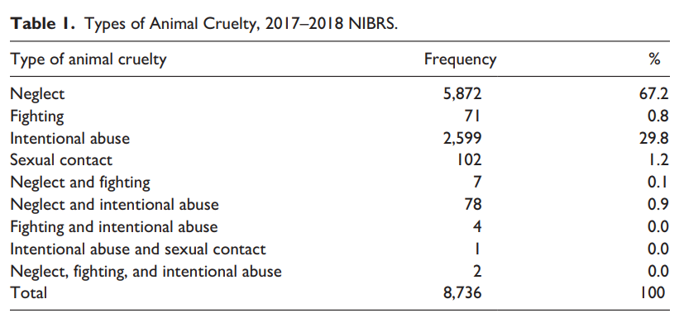
NIBRS studies can show:
Intentional Cruelty Versus Neglect: New Insights on Animal Cruelty Crimes and Implications for Policy, Lynn A. Addington and Mary Lou Randour
Unclassified

Slide 30
Texas NIBRS Data
Homicide Offense Characteristics
Pinpoint the most common weapon used in homicides and show other offenses linked to the homicide.
*
*
*These are the top five weapon types and other offenses reported in the same incident.
Unclassified

Slide 31
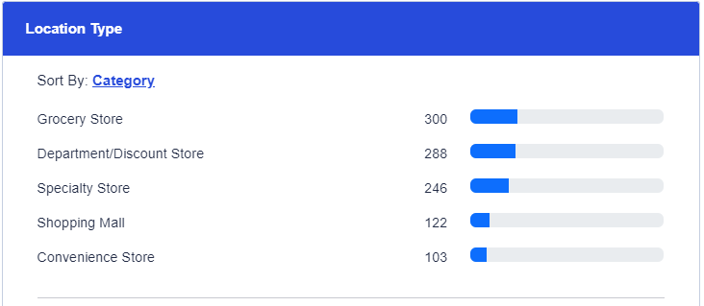
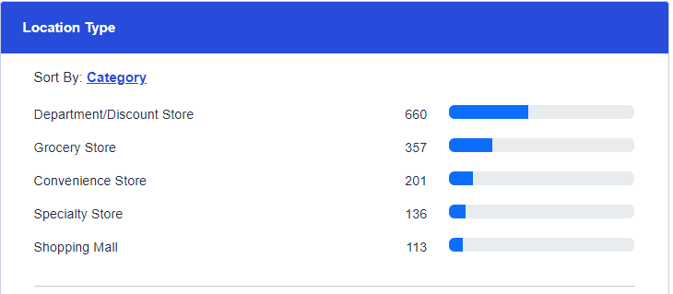
Texas NIBRS Data
Pinpoint the most common location type where shoplifting is occurring.
Arlington
Corpus Christi
Unclassified

Slide 32
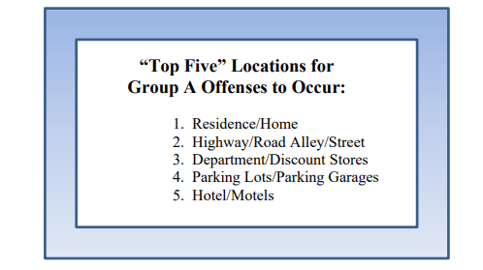
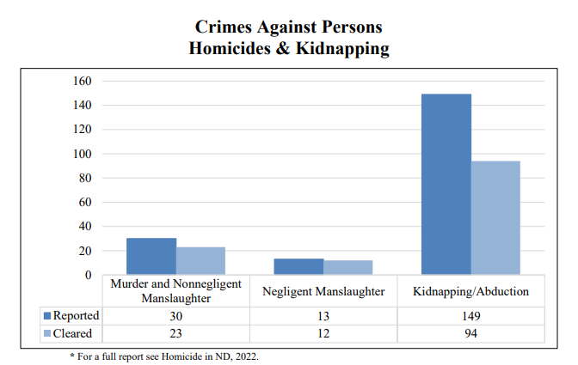
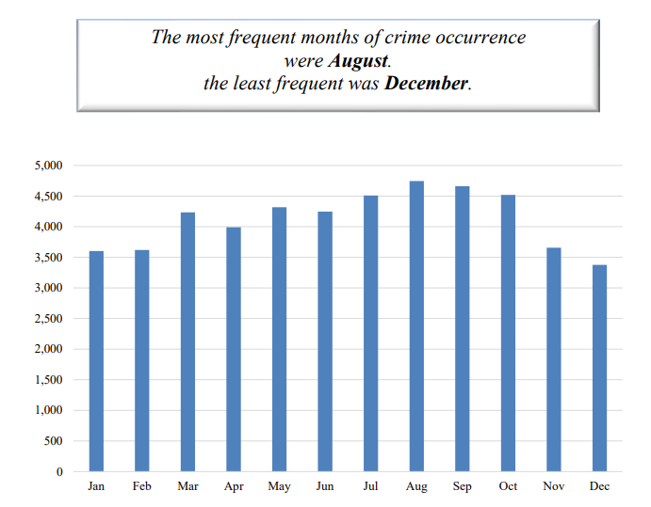
North Dakota NIBRS Data
Unclassified

Slide 33
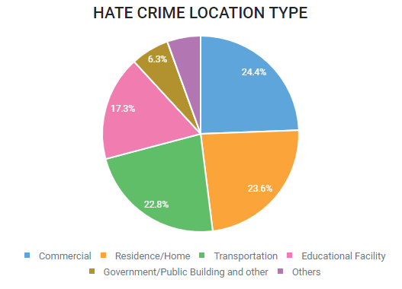
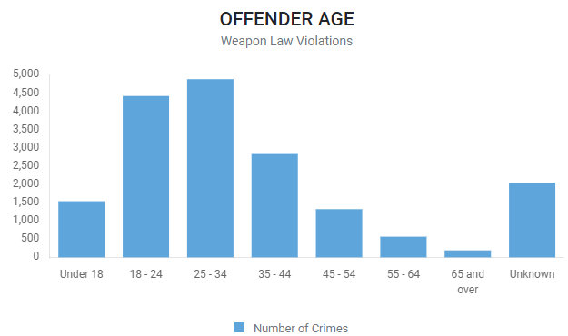
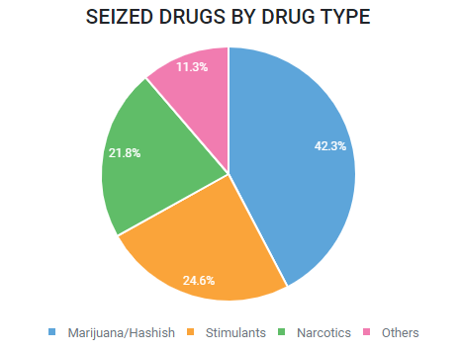
Tennessee NIBRS Data
Unclassified

Slide 34
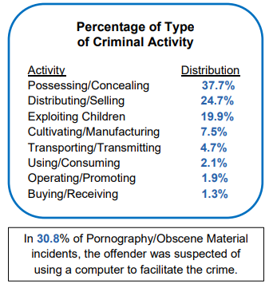
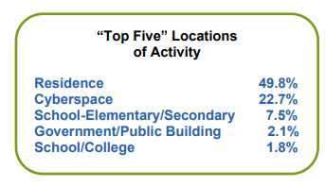
Washington NIBRS Data
Pornography/Obscene Material
FBI Definition: The violation of laws or ordinances prohibiting the manufacturing, publishing, sale, purchase, or possession of sexually explicit material, i.e., literature, photographs, etc.
Unclassified

Slide 35
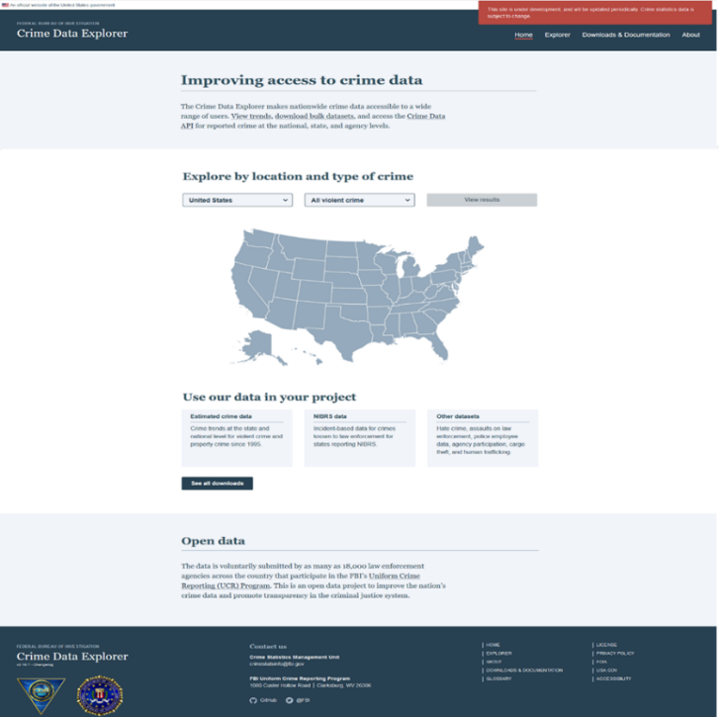
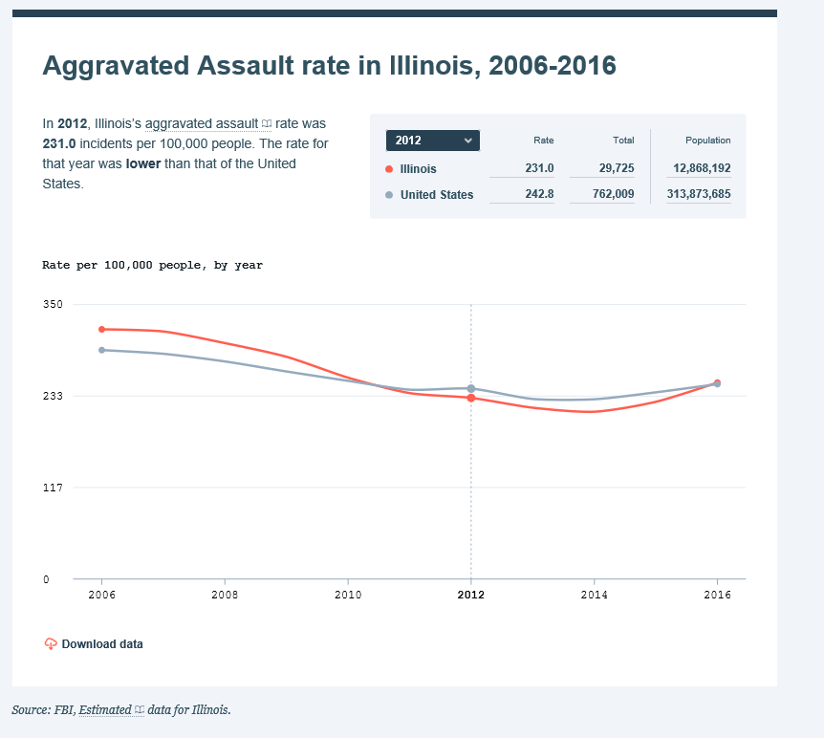
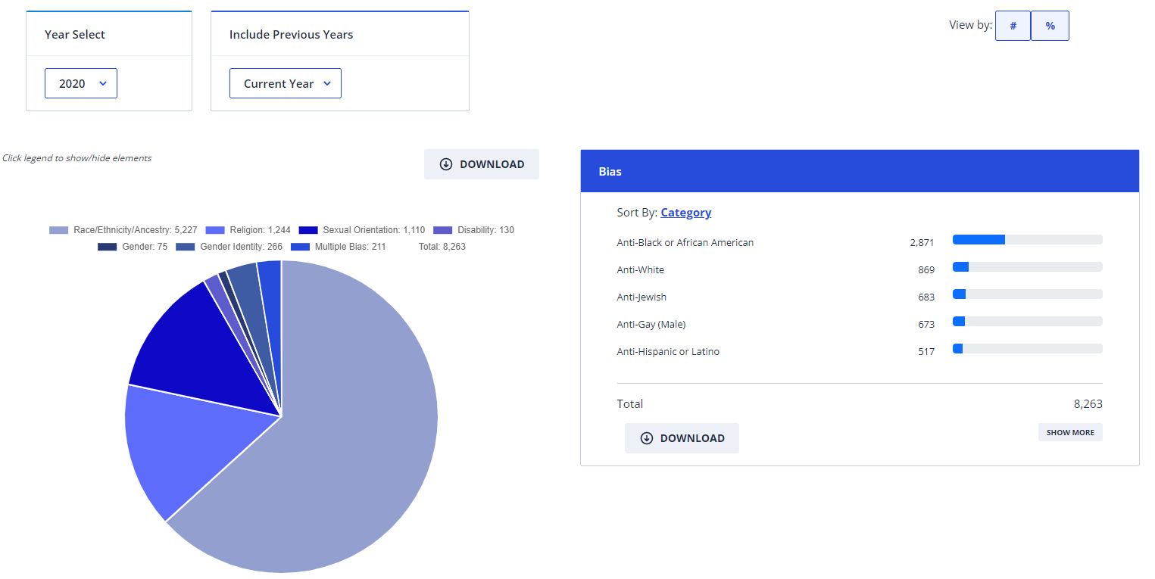
NIBRS Data can be found here:
Crime Data Explorer
www.fbi.gov/cde
Unclassified

Slide 36
NIBRS Resources
TX Department of Public Safety www.dps.texas.gov
https://txucr.nibrs.com/
https://www.dps.texas.gov/section/crime-records
NIBRS Website: https://www.fbi.gov/services/cjis/ucr/nibrs
NIBRS E-mail Address: UCR-NIBRS@fbi.gov
NIBRS Training: 888- 827-6427 or ucrtrainers@leo.gov
Unclassified

